Slide 1



Knowledge Sharing and Team Working
Course Introduction
Svetlin Nakov
Manager Technical Training
www.nakov.com
Telerik Software Academy
academy.telerik.com

Slide 2



Table of Contents
Course Objectives & Program
Team Work Projects
Assessment
Learning Resources

Slide 3



The Culture of Knowledge Sharing and Collaboration
Open Education, Knowledge Sharing, Team Working, Helping Others

Slide 4

Open Knowledge and Education
What is "open knowledge sharing"?
A modern concept in education and society
Knowledge becomes open to the world
High-quality training becomes free
Idea broadly supported by:
World's top universities like Harvard, MIT, Berkeley, Stanford, Oxford, Cambridge, …
Online free training MOOC sites:
Khan Academy, Coursera, Udacity, edX, Ucha.se, Codecademy, Code School, Telerik Academy, …

Slide 5

The World Becomes Open!
Open Education
http://en.wikipedia.org/wiki/Open_education
Citizen Science (Open Science)
http://en.wikipedia.org/wiki/Citizen_science
Open Knowledge Foundation
http://okfn.org
Open Knowledge Conference
http://okcon.org
Open Government
http://www.opengovpartnership.org

Slide 6
The Culture of Helping Others
“If you light a lamp for someone else, it will also brighten your path.” ~Buddha
How it works?
Initially you get help from the others
E.g. from the Software Academy
You start a good job, have a good quality of life, good incomes, etc.
Give back 10% of what you have to help others
E.g. help by volunteer work, by charity or by sharing your knowledge and skills

Slide 7



Course Objectives & Program
What Topics Shall We Cover?

Slide 8

The Course Objectives
Knowledge Sharing and Team Working goals
Develop a culture of open sharing of knowledge
Learn to enjoy helping others
Learn to work in a team
Real-world practical projects
Teams of 3-7 people
Help the software academy to grow and operate its free trainings
Promote the free trainings / assist in teaching

Slide 9
Course Benefits
Benefits from the course
Adopt the open knowledge sharing culture
Build your own blog
Your blog is more than online CV!
Build your own public developer profile (at GitHub / Google Code / CodePlex)
Get team working experience
On real-world projects, in real teams
Learn how to learn: mind mapping, speed reading and efficient learning

Slide 10
Course Program
Part I – Knowledge Sharing and Efficient Learning
Course Intro & Open Knowledge Sharing Culture
Software Engineering Motivational Essay
Starting Your Own Blog: How to Share Knowledge and Help Others?
Source Control Systems for Project and Team Collaboration: SVN, TFS and Git
Mind Mapping: Efficient Notes and Creativity
Efficient Learning: Speed Reading and Memory Techniques (by Tony Buzan)

Slide 11

Course Program (2)
Part II – Team Working
Presenting the Team Work Projects
Application Process
Teams Work on Their Individual Projects
Internal Meetings
Project Activities
Prepare for Public Defense
Public Defense (periodically)
Public Presentation

Slide 12
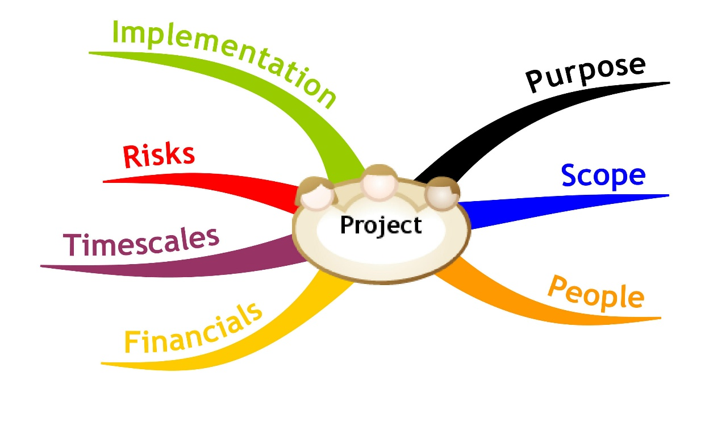
Team Work Projects
Application Process, Team Work Process, Examples

Slide 13
Team Work Projects: The Process
The process for working on the team projects:
Students sign-up for a team work (optionally)
The system distributes the students in teams
The trainers assign team work projects
The students find each other and begin work
Students work on their projects
Assign tasks, collaborate, communicate, perform meetings, collaborate, merge the results, etc.
Perform a public defense (presentation)
Asses each team member and give feedback

Slide 14
Sample Team Work Projects
Write a Wikipedia article about programming
E.g. "sorting algorithms", "GitHub", "C#"
Write a console-based game
E.g. Snake / Tetris / Minesweeper / Falling Rocks
Create a web site
E.g. a site for fun stories / fun images
Create a JavaScript web-based game
E.g. Tetris / Falling Rocks / Xonix

Slide 15
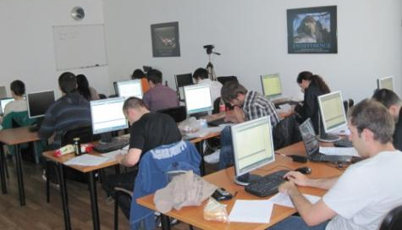
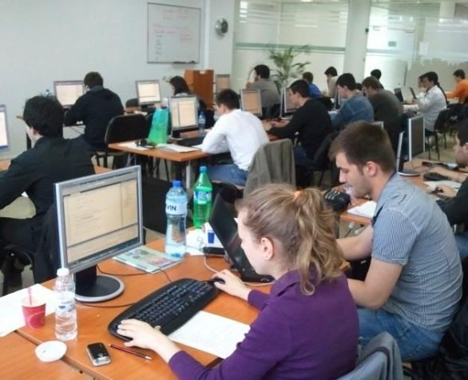
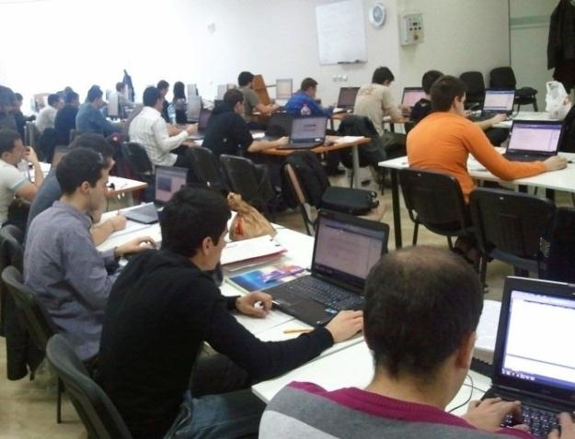
Assessment
Assessment Criteria

Slide 16


Assessment
Part I – Knowledge Sharing
Blog – 50%
Essay – 20% (bonus)
Source Control Systems – 20%
Mind Mapping & Efficient Learning – 30%
Part II – Team Working
Team Score – 70%
Peer Evaluation – 30%

Slide 17

Pass-Fail Criteria
To "pass"
At least 30% of score for Part I
Essay+ Blog + Source Control Systems + Mind Mapping & Efficient Learning
Participation in a team work
To "pass with excellence"
At least 70% of Part I score
Good team work project
The course is optional
Gives 20% of the score for this semester!

Slide 18








Resources
What We Need in Addition to This Course Content?

Slide 19
Course Web Site & Forums
Register for the "Telerik Academy Forums":
Discuss the course exercises with your colleagues
Find solutions and assistance for the exercises
Share source work / discuss ideas
The course official web site:
http://forums.academy.telerik.com/knowledge-sharing-and-team-working
academy.telerik.com/student-courses/soft-skills-and-business-skills/teamwork/

Slide 20


Books
Buzan Study Skills Handbook: The Shortcut to Success in Your Studies with Mind Mapping, Speed Reading and Winning Memory Techniques
by Tony Buzan, Pearson Education, 2007 ISBN 978-1-4066-1207-3
Как да уча бързо и да запомням лесно
Тони Бюзан, Софтпрес, 2011 ISBN 978-954-685-837-5

Slide 21
Knowledge Sharing and Team Working – Course Intro
http://academy.telerik.com

Slide 22
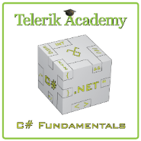



Free Trainings @ Telerik Academy
C# Programming @ Telerik Academy
csharpfundamentals.telerik.com
Telerik Software Academy
academy.telerik.com
Telerik Academy @ Facebook
facebook.com/TelerikAcademy
Telerik Software Academy Forums
forums.academy.telerik.com

